Slide 1

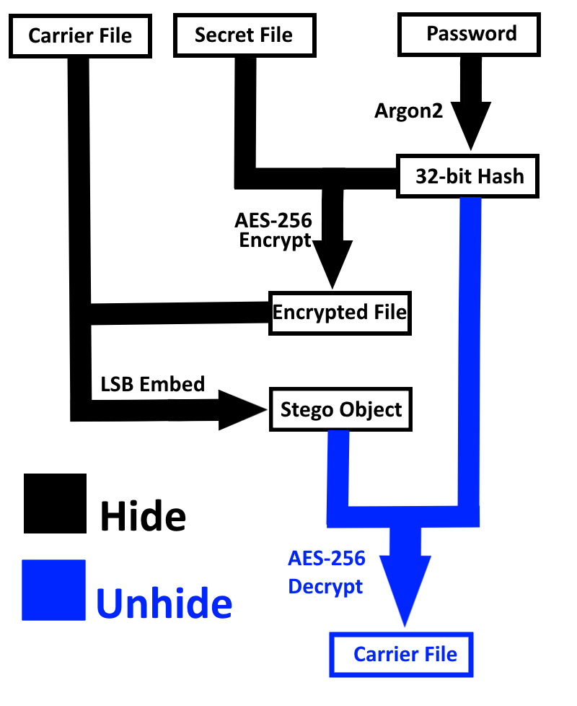
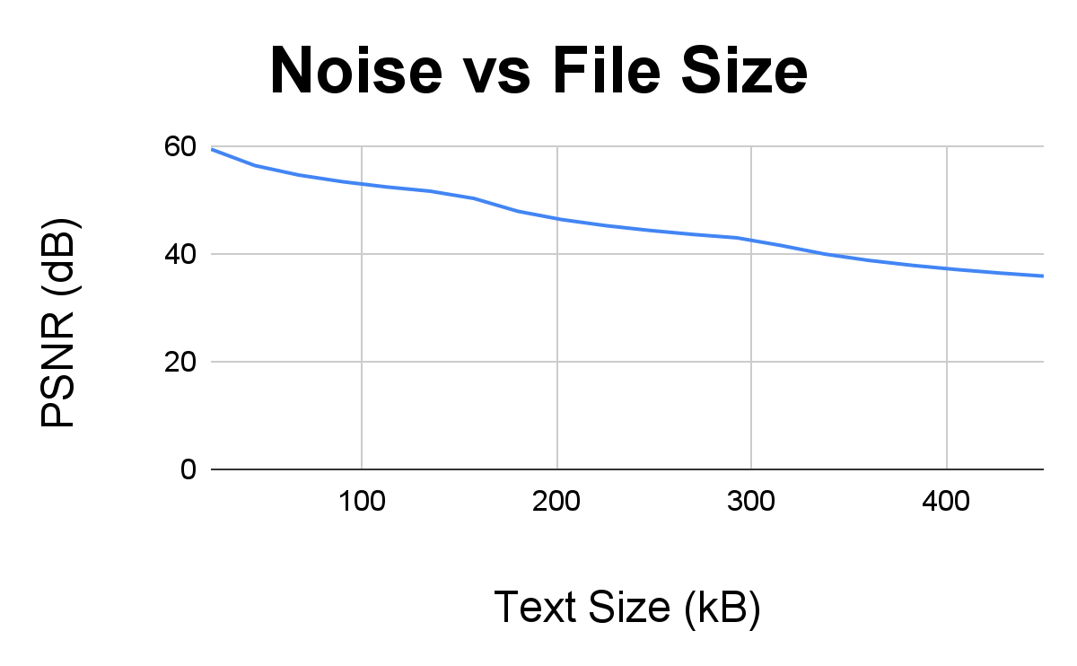
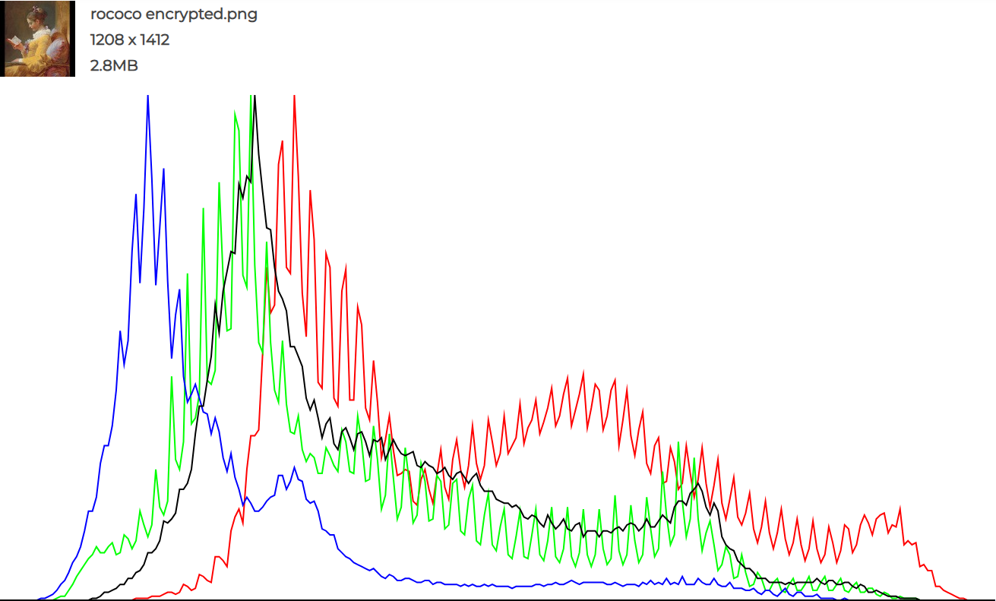
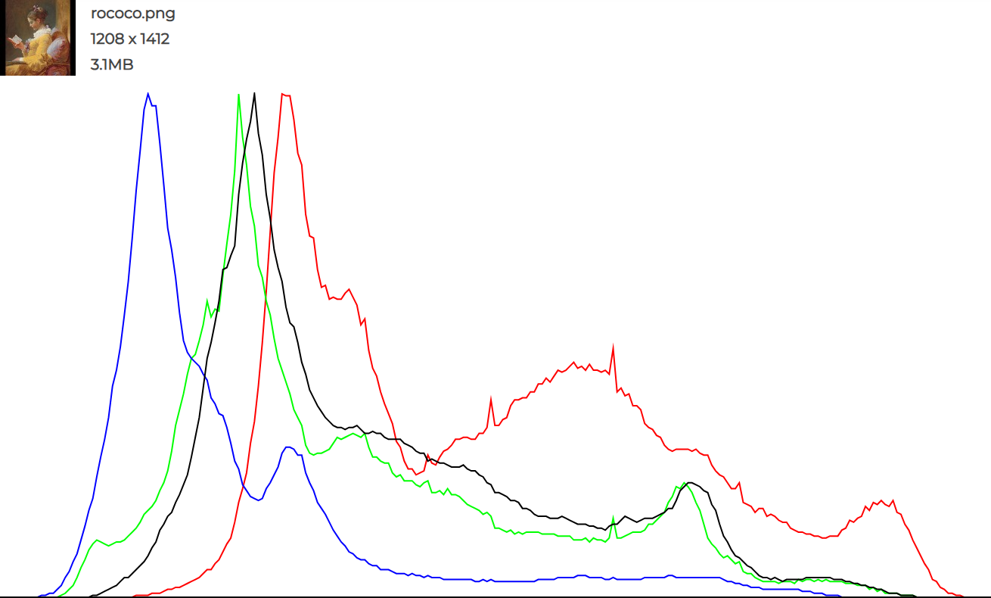
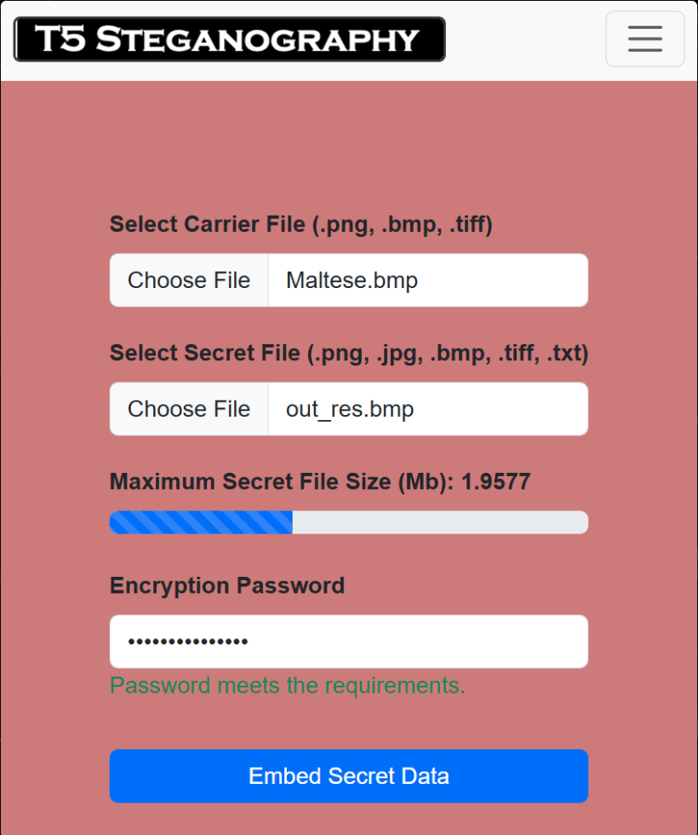
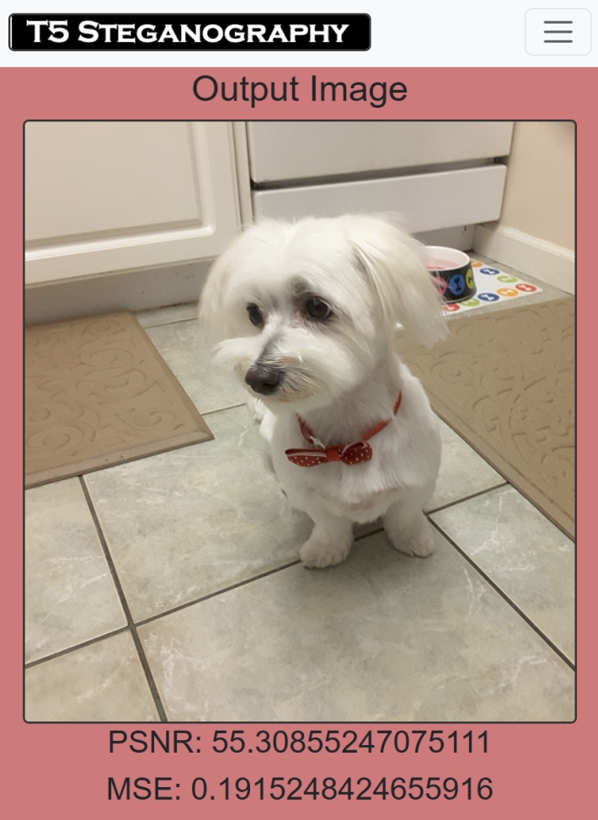
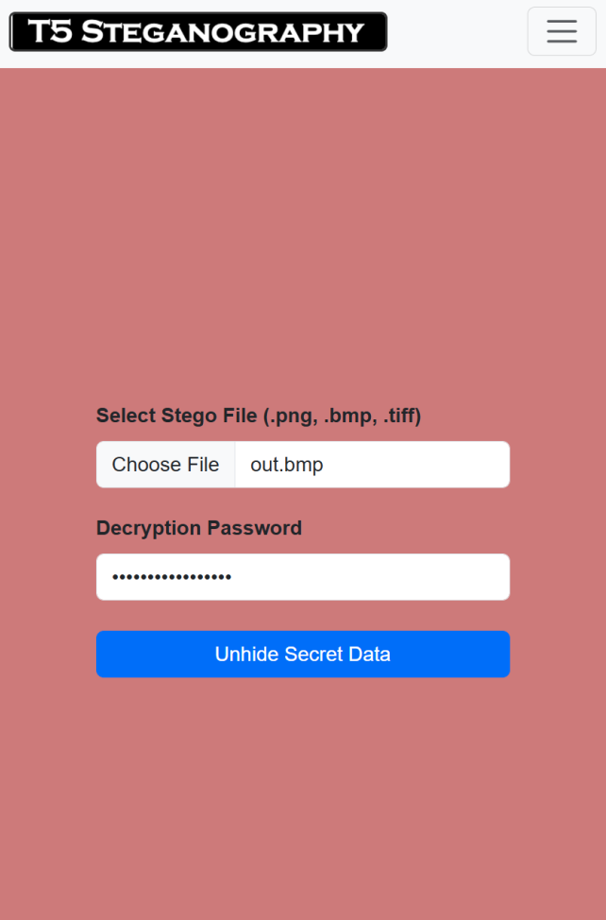
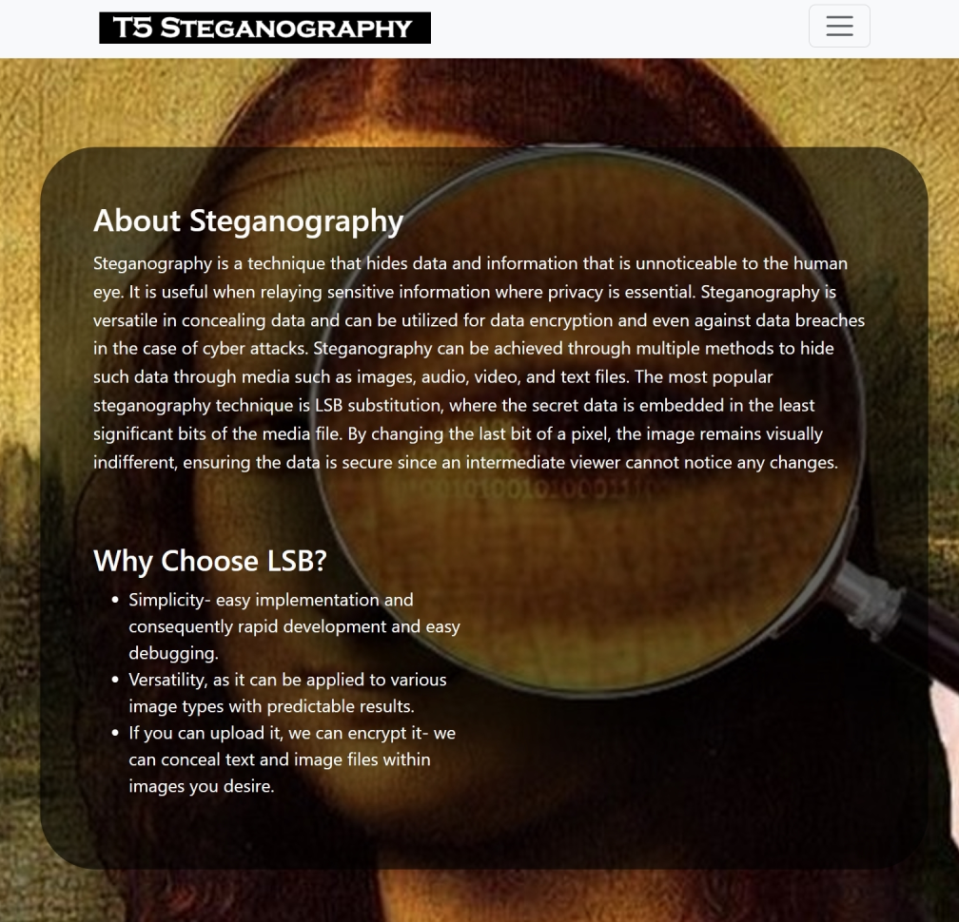
Digital Steganography
Jeremy Davidson Camila Frontani Hitarth Mistry Kristopher Pally Mohammad Siddiqi Ritika Singh
Senior Design Project at The University of Texas at Dallas, Fall 2024
Erik Jonsson School of Engineering & Computer Science
Faculty Advisor – Dr. Salih Raed | Faculty Sponsor – Dr. Razo
Abstract
Steganography is a technique that hides data and information that is unnoticeable to the human eye. It is useful when relaying sensitive information where privacy is essential. Steganography can be utilized for data encryption and even against data breaches in the case of cyber attacks. Steganography can be achieved through multiple methods to hide such data through media such as images, audio, video, and text files. The most popular steganography technique is LSB substitution, where the secret data is embedded in the least significant bits of the media’s file. By changing the last bit of a pixel, the image remains visually indifferent. This can be verified by calculating PSNR values, ensuring the data is secure, since an intermediate viewer cannot notice any changes despite histograms showing RGB differences. Keywords: Cyber Security & Privacy, LSB, Encryption
System Design
Performance Metrics
Provides feedback to user when encrypting such as maximum secret file size, password strength, supported/unsupported file types, as well as metrics for the noise levels.
Guarantees low noise on image when encrypting
User friendly UI that is scalable, auto-adjusts to different sized screens and easy to understand.
Allows user flexibility when uploading image types
Hashing allows for resistance against pre-computed attacks
Text Here
Impact
Enables friends/families to send secret messages to people without the risk of private data being intercepted by government agencies
Allows for safe and discreet communication within an intelligence agency’s network
Can be used to watermark/spot image alterations
Activist groups can organize and share plans to provide information such as refuge coordinates, e.g. regarding the safe passage of women/children in warzones
Carrier File: File that is used as a cover for the secret data.
Stego Object: File that looks like the carrier file, but has the secret data embedded.
Argon2: Hashing Algorithm
AES-256: Encryption Algorithm
LSB embed: Embed secret data in the last bits of the carrier file’s binary data.
Results
User Interface

